Slide 1





ByteMe tech inc.
P&ID
ASSISTANT
View, remix, and save ideas in one vibrant web playground.
PRESENTED BY:
Apoorv Grover
Hitesh Singla
Khushal Hingorani

Slide 2
02/10
PROJECT OVERVIEW
Our P&ID Assistant revolutionizes classic piping‑and‑instrumentation workflows by turning static diagrams into interactive, JSON‑driven flowcharts. Combining computer vision, LangChain‑powered chat edits, and a realtime dashboard, it slashes manual grunt work—auto‑detecting symbols, exporting structured data, and surfacing analytics at the click of a button. The result? Engineers iterate faster, collaborate seamlessly, and gain actionable insights from every P&ID.

Slide 3
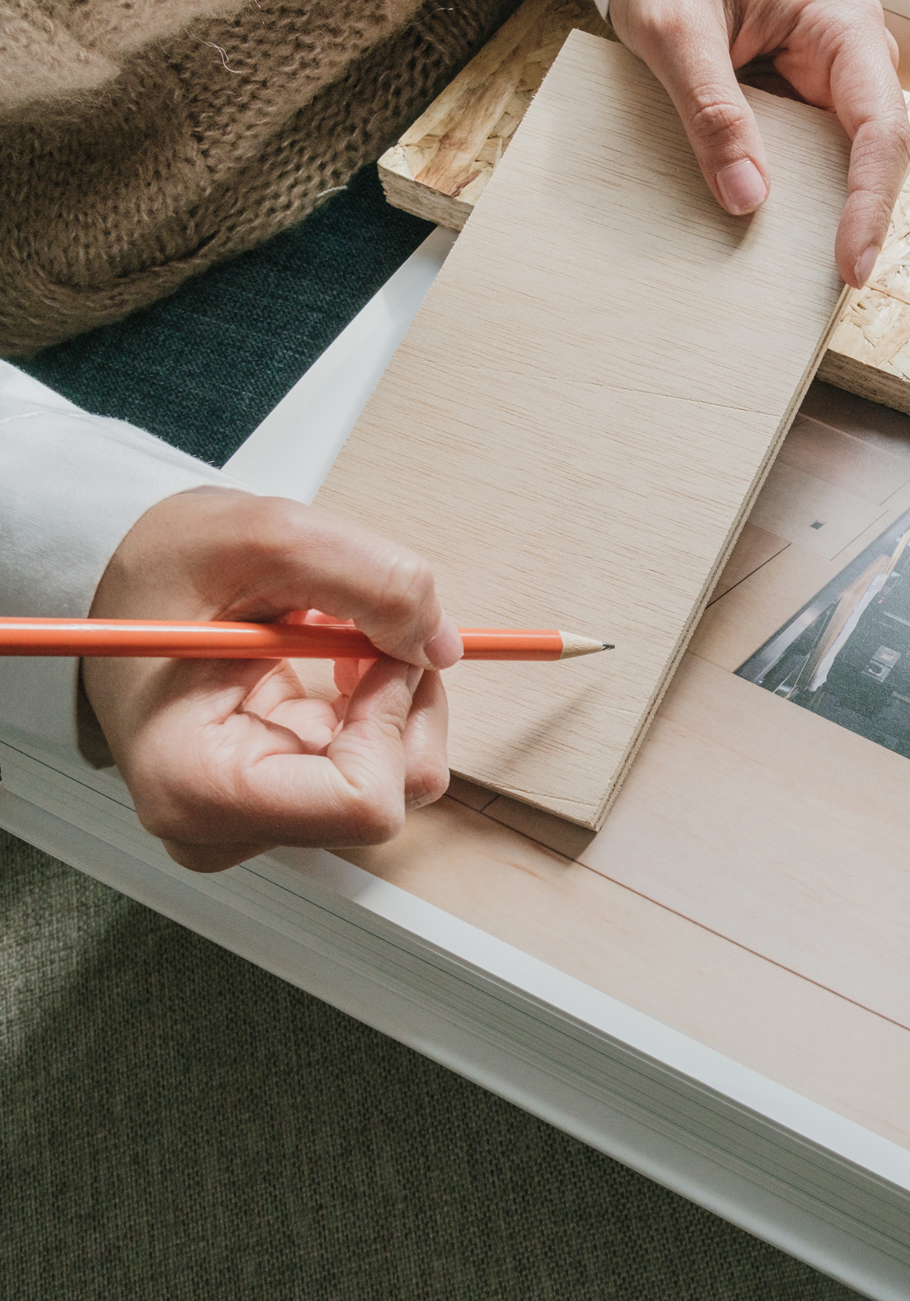
01
Our industry still hand‑edits P&ID diagrams in CAD tools super manual and error‑prone
02
Build an end‑to‑end AI‐powered P&ID Assistant that:
Auto‑detects & labels symbols and text
Emits a live JSON tree for React‑Flow‑style flowcharts
03
>95 % detection accuracy on benchmark P&IDs
70 %+ reduction in manual drafting & revision time

Slide 4


04/10
Objectives and Goals
Goal # 1
Goal # 2
Goal # 3
Revolutionize P&ID Workflows
Boost Engineer Productivity
Deliver Data‑First Insights

Slide 5
05/10
Resource
Page
Symbol Detection & Counting
– Used the Automated‑PnID‑Symbol‑Detection‑and‑Labelling model to spot & tally pumps, valves, sensors, etc.
Flowchart & JSON
– jsontree + JSON Schema to map symbols into nodes/edges.
– OpenAI (GPT‑4 ) + Google Gemini 2 Flash handle natural‑language flow edits & plan generation.
AI Orchestration
– LangChain Agents route user chats into JSON diffs or analytics calls.
– MCP Server hosts each micro‑agent (detection, JSON builder, chat, analytics) as REST services.
Frontend & Dashboards
– React‑Flow for drag‑n‑drop diagrams.
– Google Gemini 2 Flash for the Info tab’s counts, BOM exports, and KPI charts.
Infra & Data
– MongoDB Atlas for JSON/version history.
– Docker + Kubernetes (via MCP) & GitHub Actions for CI/CD.

Slide 6


Timeline
06/10
1st Quarter
2nd Quarter
3rd Quarter
4th Quarter
Structure and methodology
frontend and model selection
ai agents and
backend integration
polishing and final testing

Slide 7

Our team
07/10
APOORV GROVER
HITESH SINGLA
KHUSHAL HINGORANI
AI dev and mcp server integration
Frontend dev and integration
Backend dev

Slide 8
08/10
Thank you
www.reallygreatsite.com

